Slide 1
Sustainable development (Agenda 2030)
FINAL EVENT Open commUniTies for SustaInable DevelopmEnt
Tuesday, February 21, 2023, 9:00 a.m.
Catanzaro, Viale Crotone
The European Commission's support for the production of this publication does not constitute an endorsement of the contents, which reflect the views only of the authors, and the Commission cannot be held responsible for any use which may be made of the information contained therein.
OUTSIDE - Open commUniTies for SustaInable DevelopmEnt Nr. 2020-1-IT02-KA201-079803

Slide 2
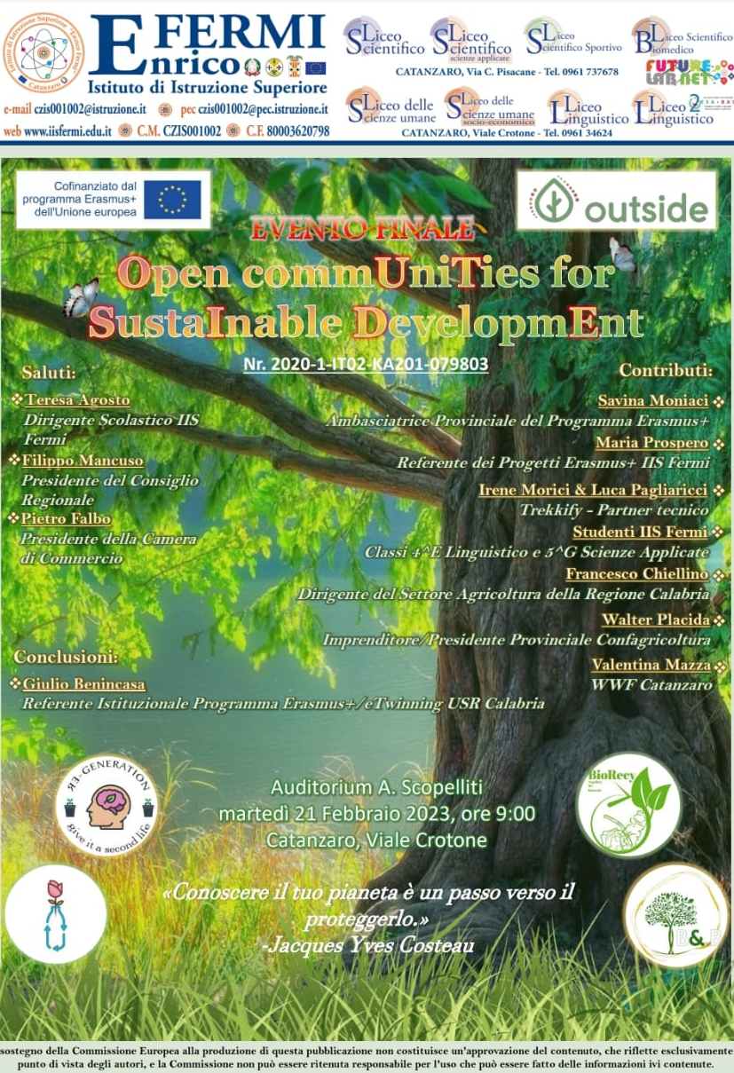
The final event of the Erasmus+ kA2 project entitled "Outside"- Open commUniTies for SustaInable DevelopmEnt" was held on Tuesday, February 21, at the A. Scopelliti auditorium of the IIS Fermi of Catanzaro Lido. Funded by the European Community and included in the Erasmus+ Mixed Strategic Partnerships program, the project involved the IIS "Fermi " of Catanzaro Lido, lead school led by Headmistress Teresa Agosto and involved schools and associations from Belgium, Lithuania, Croatia and the United Kingdom.

Slide 3
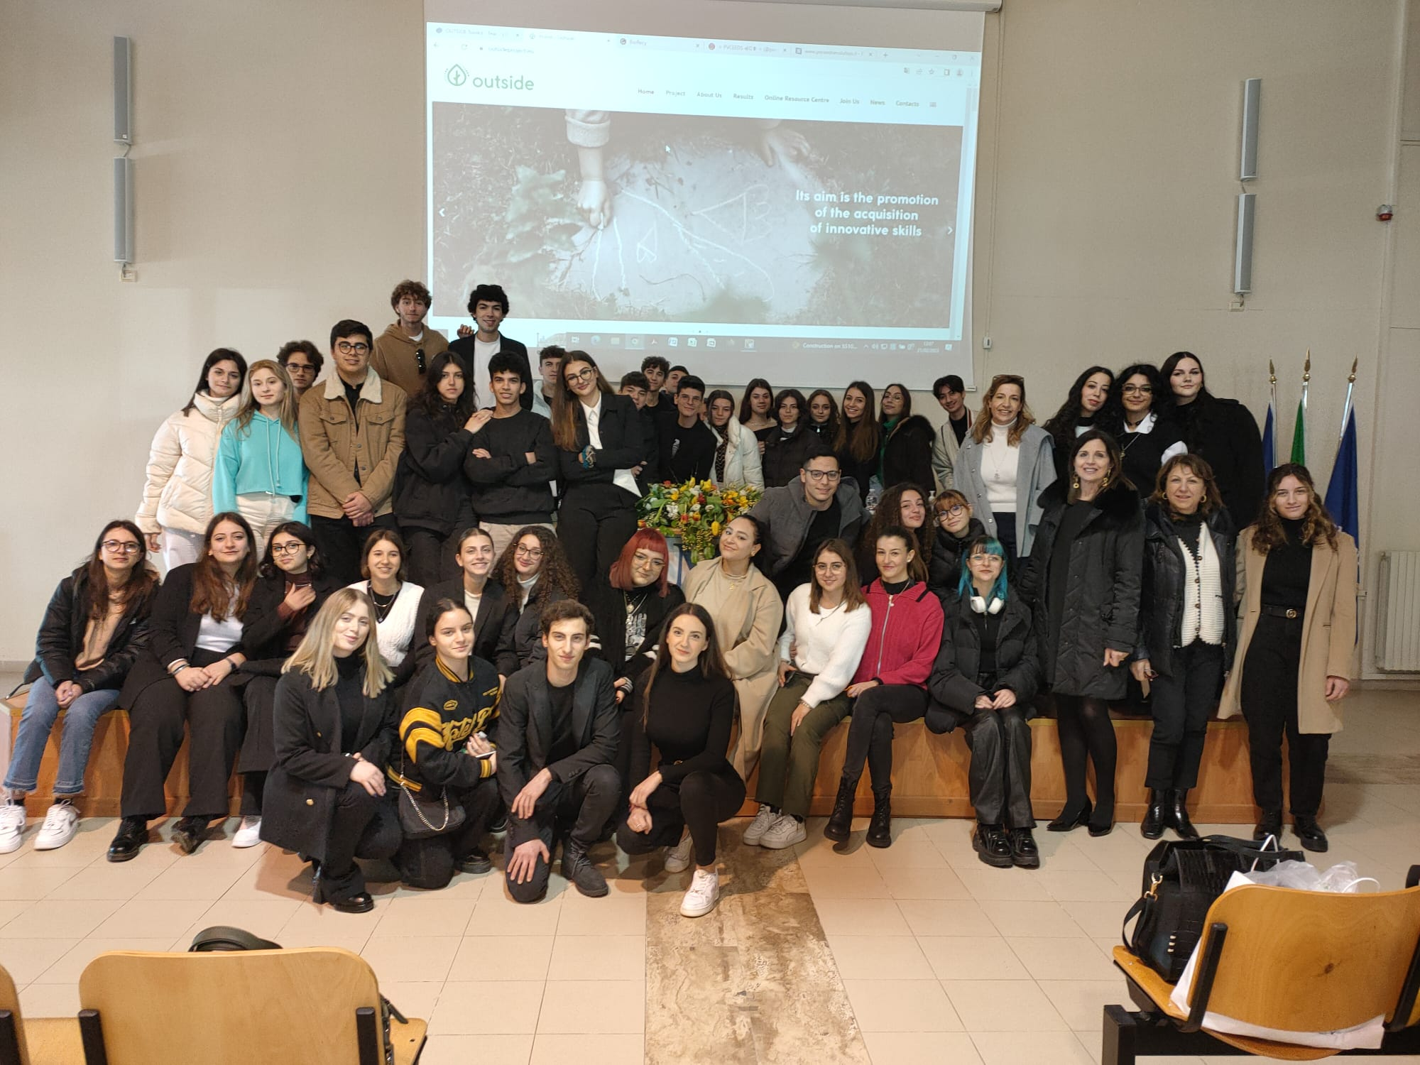
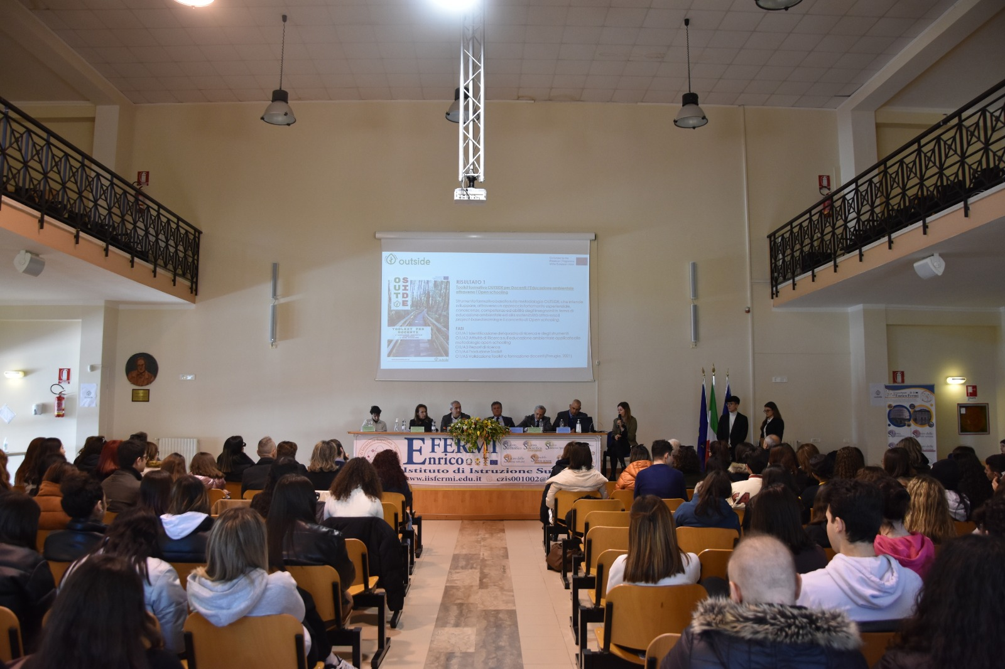
The initiative, enlivened and strengthened by the presence of all the protagonists , the classes IV E of the Liceo Linguistico and VG of the Liceo Scientifico and their family members, Mrs. Maria Prospero, referent of the Erasmus + projects of IIS Fermi, the referent teachers Mauro Romilde and Giovanna Valeo , the technical partners, Irene Morici and Luca Pagliaricci of the Associazione "Trekkify," was a multi-voiced account of the educational and training experiences gained by the beneficiaries over the past three school years .

Slide 4
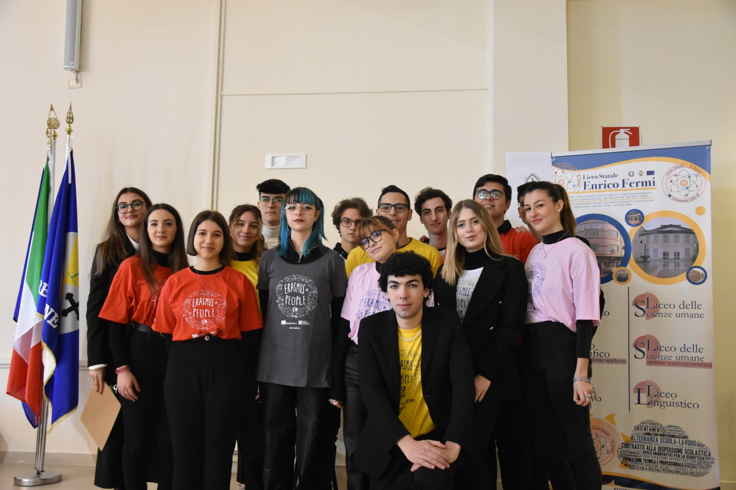
The occasion provided an opportunity to compare, share and, at the same time, disseminate the objectives achieved as a concrete tool for communication and enhancement of the path undertaken, through the analysis of the different actions implemented and the evidences of the beneficiaries.

Slide 5
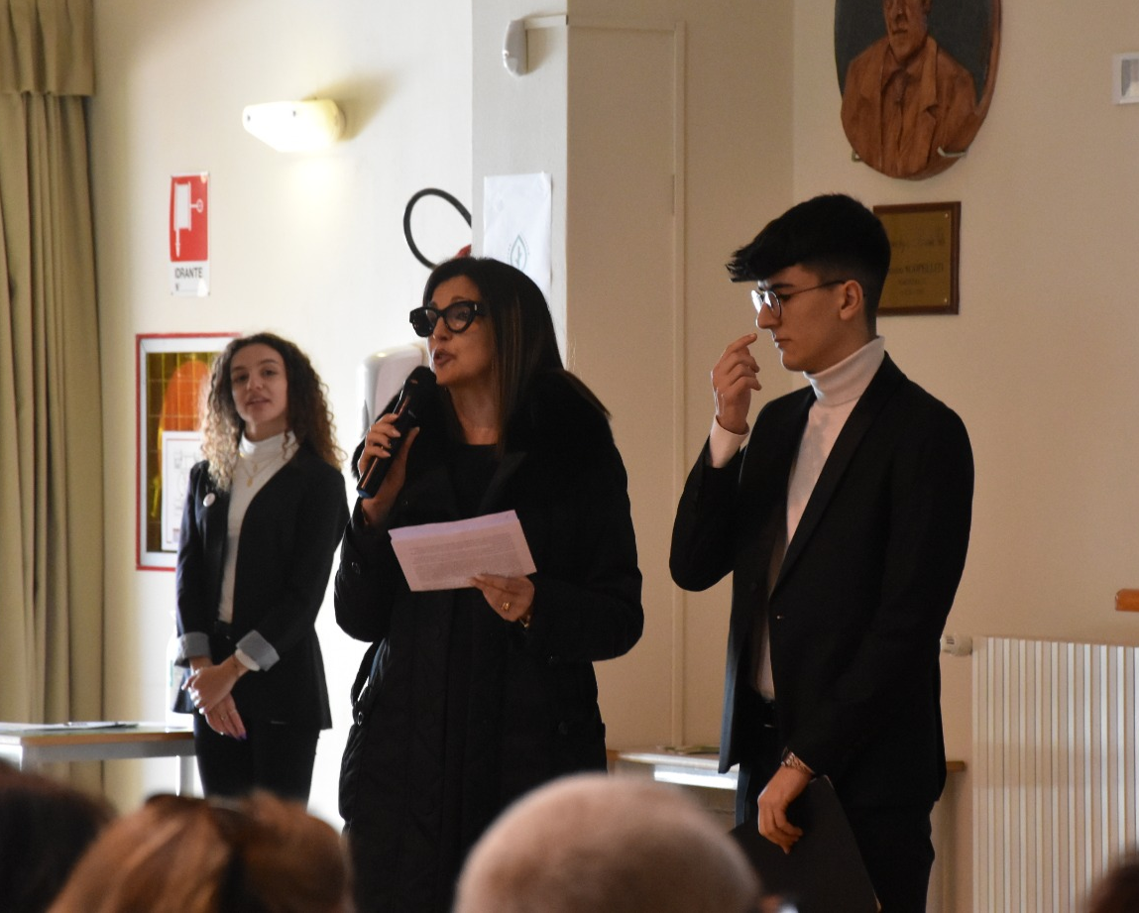
Mrs. Maria Prospero, contact person for Erasmus + projects at IIS Fermi, in greeting all those present, explains that the event will be run entirely by the students who, as an evidence to their growth, will serve as presenters at the event.

Slide 6
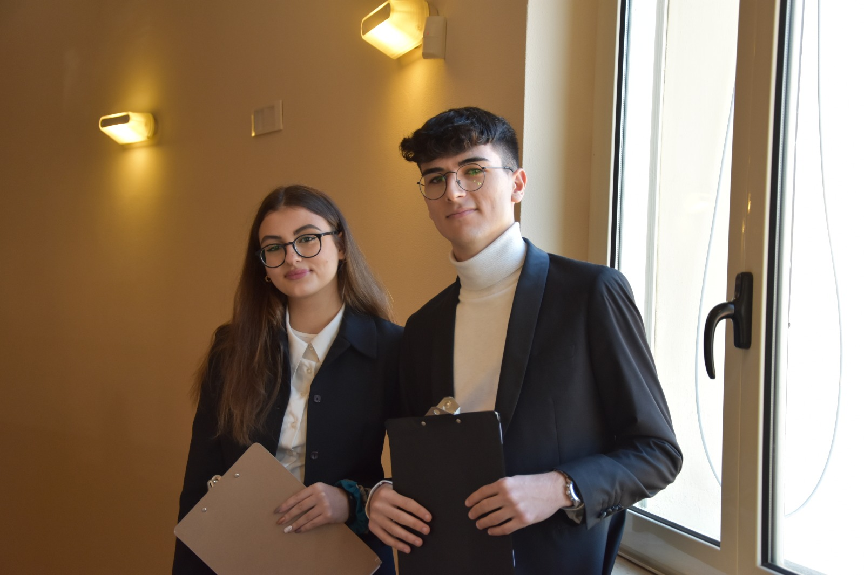
The students, Valenti Ilaria and Elia Samuele of classes IVE of the Liceo Linguistico and V G of the Liceo Scientifico first introduced the president of the Regional Council Dr. Filippo Mancuso, stressing that the intent of the project was precisely to create synergies within which one can lay the foundations to become conscious and sustainable entrepreneurs in this beautiful land of ours

Slide 7
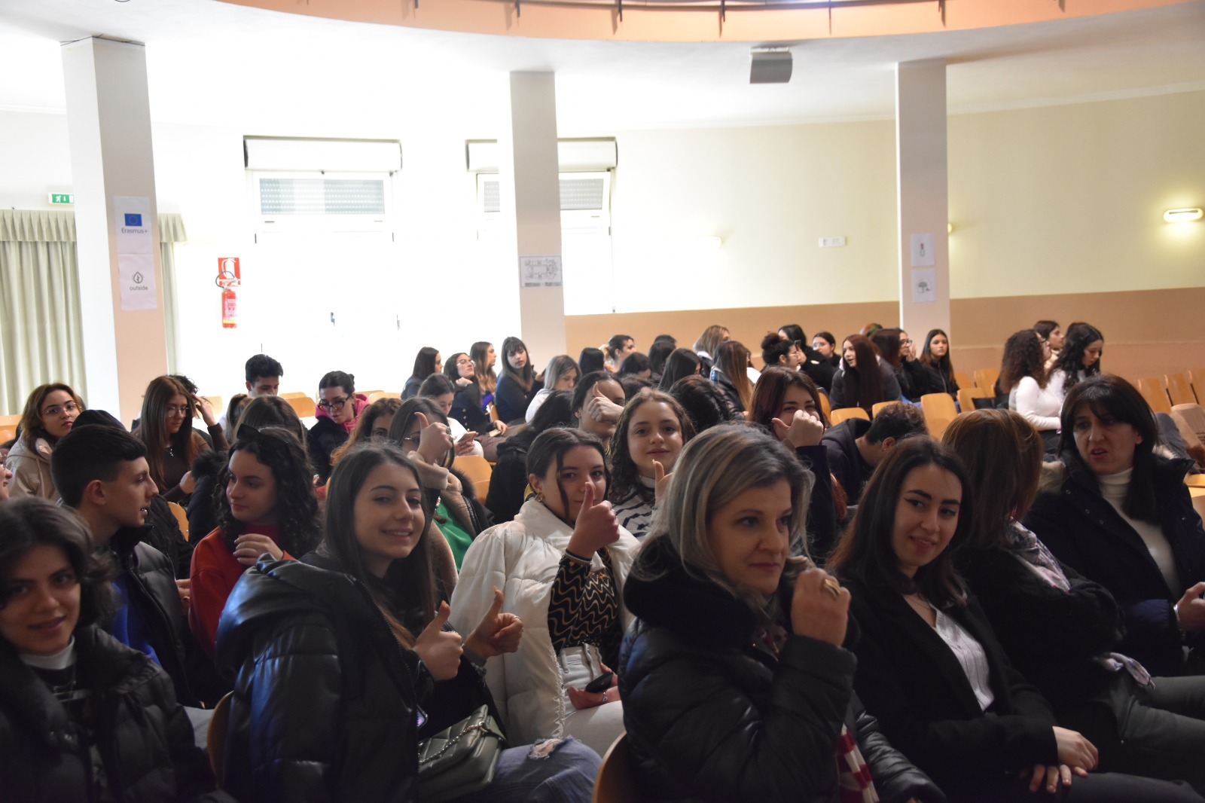
Mrs. Maria Prospero , gives a summary of what were the activities carried out under the project...

Slide 8
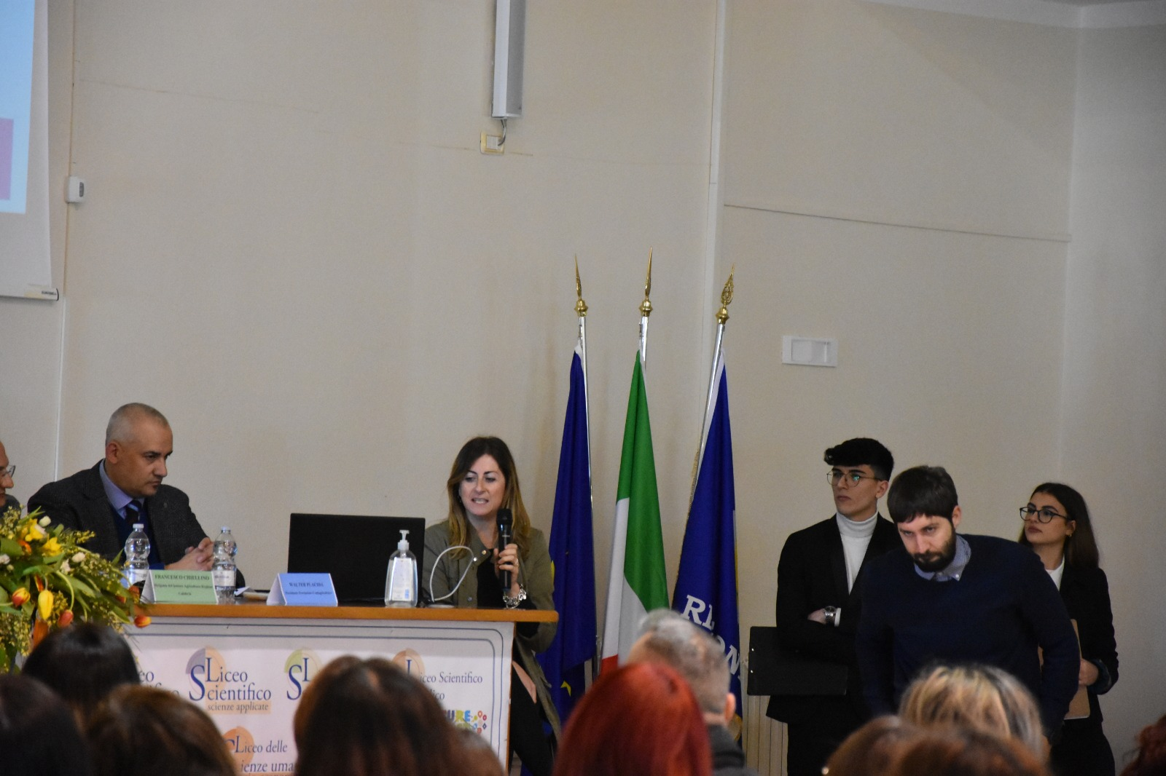
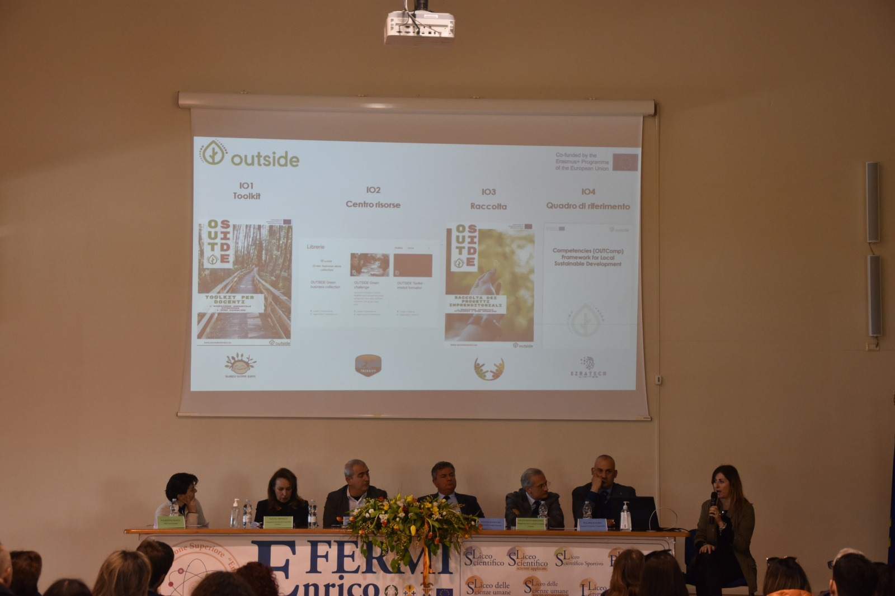
Irene Morici, a technical partner in the project along with Luca Pagliaricci, explains the technical aspects of the project

Slide 9
Getting into the thick of the project...
kids take turns presenting their projects.

Slide 10
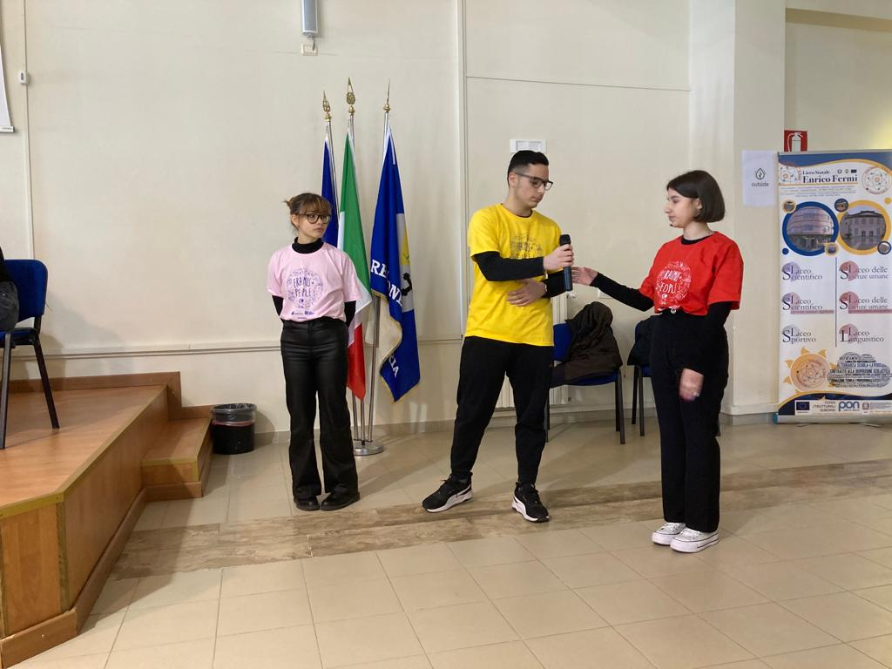
First green project: REGENERATION
Emanuele Giglio, Serena Mellace and Elisa Musca
IVE Liceo Linguistico

Slide 11
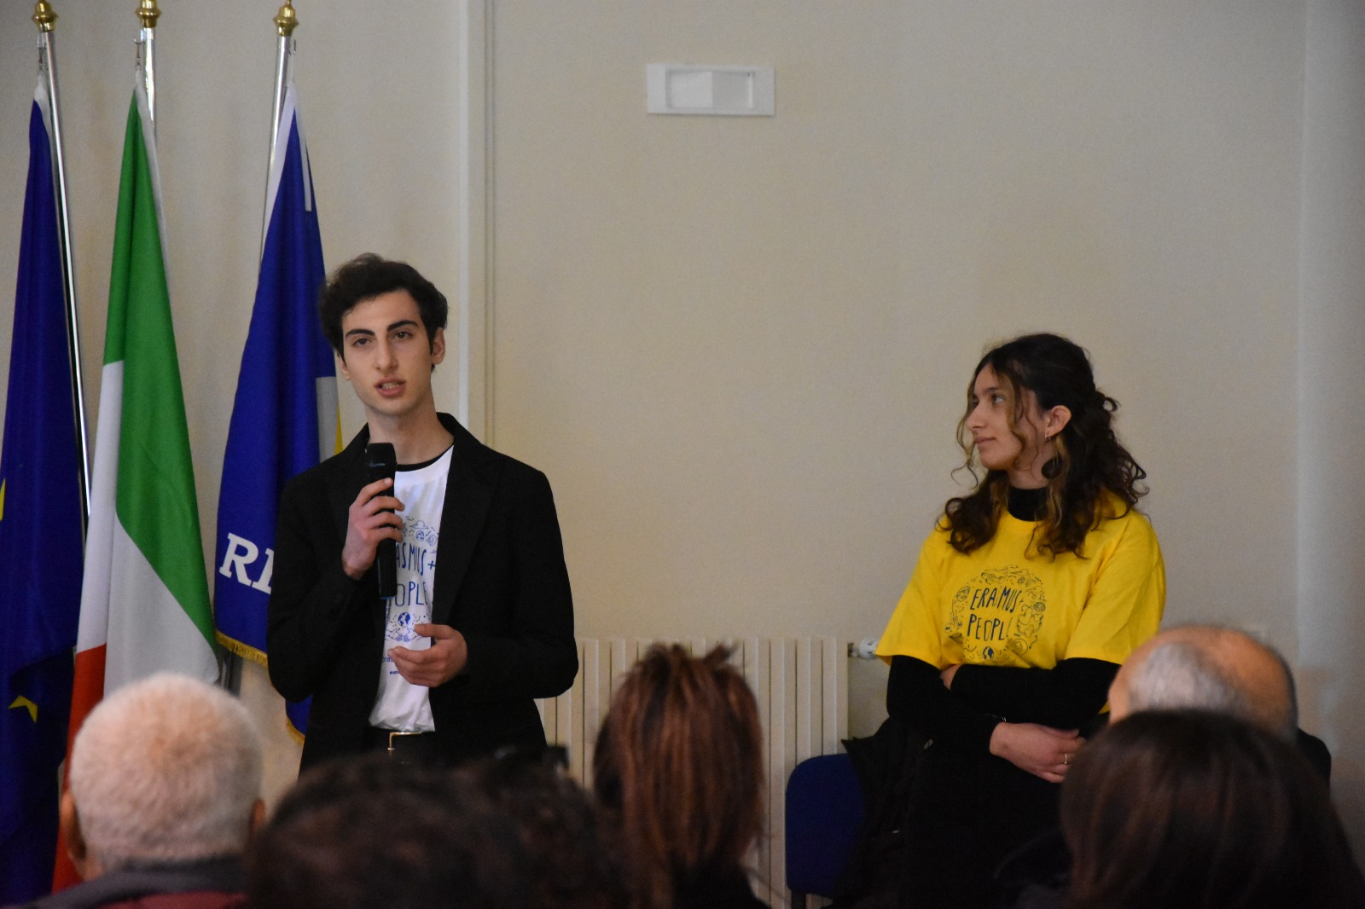
Second green project : BIORECY
Sharon Mancuso and Raoul Sacco VG Liceo Scientifico

Slide 12
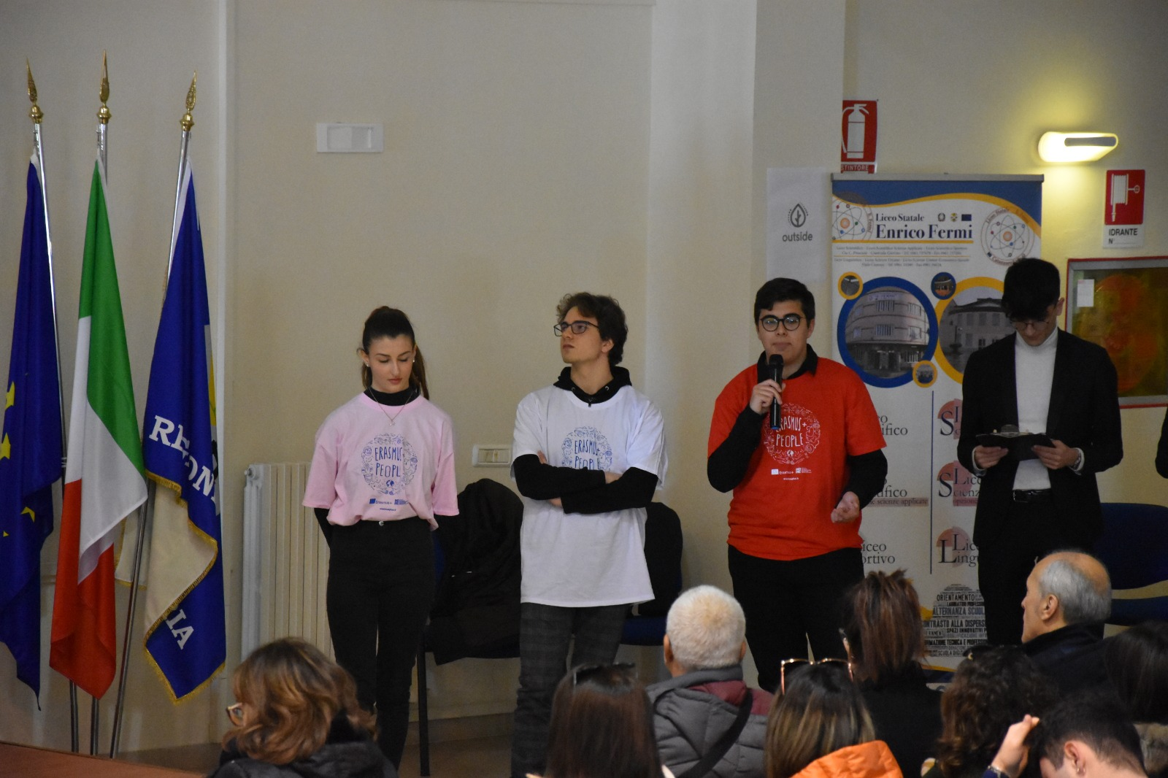
Third green project: PVCeeds
Ludovica Cosenza, Daniele Focaccio and Rocco Pio Rosanò
IVE Liceo Linguistico

Slide 13
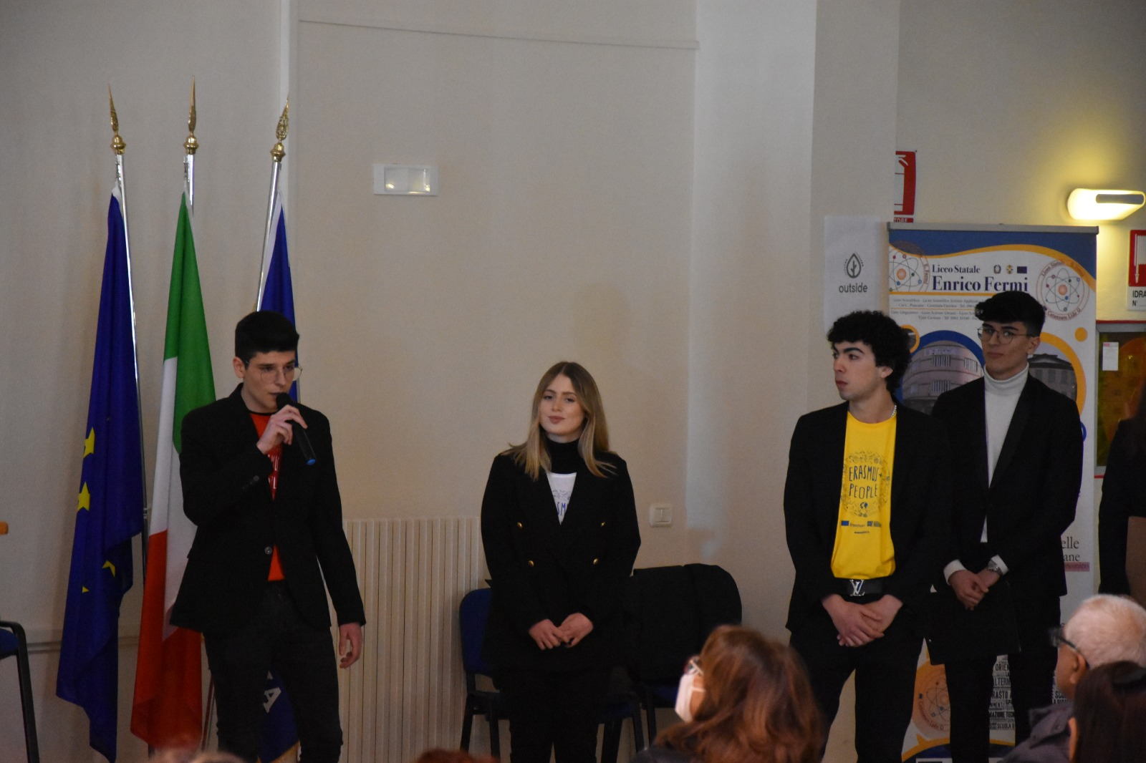
Fourth green project: B&coB
Giorgia Caccavaro, Domenico Colao and Enrico Vitale
VG Liceo Scientifico

Slide 14
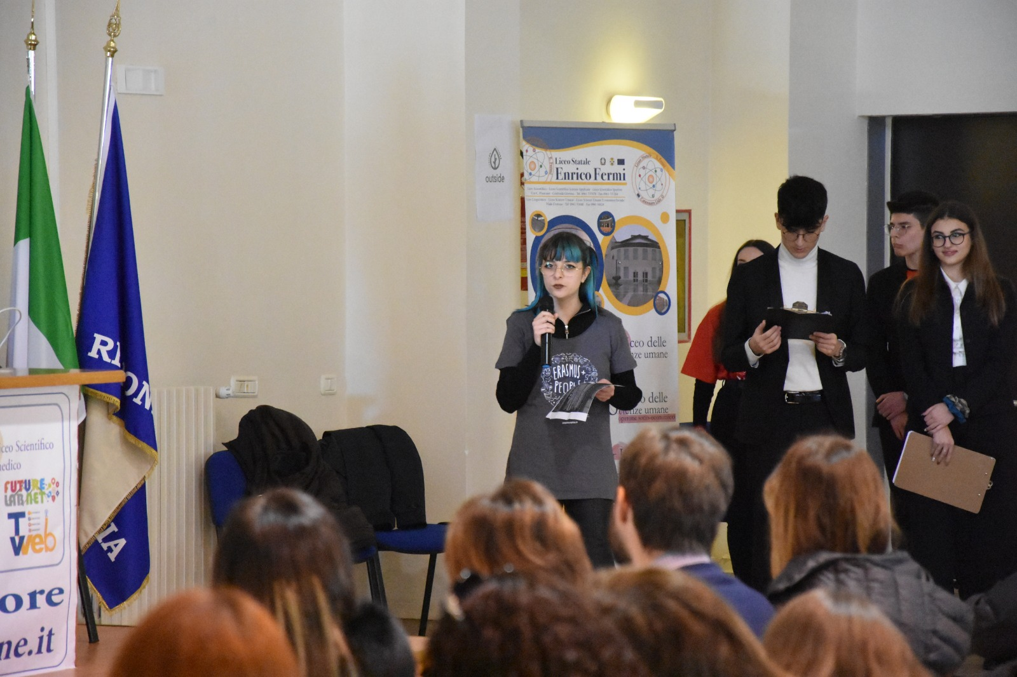
Moving were the evidences of the students who appreciated the project because "it was not just a virtual project, but a project that "gave us the opportunity to express all our ideas in front of new people, foreign people and people with cultures completely different from our own."
Sidney Rotundo VG Liceo Scientifico
Francesca Procopio IVE Liceo Linguistico

Slide 15
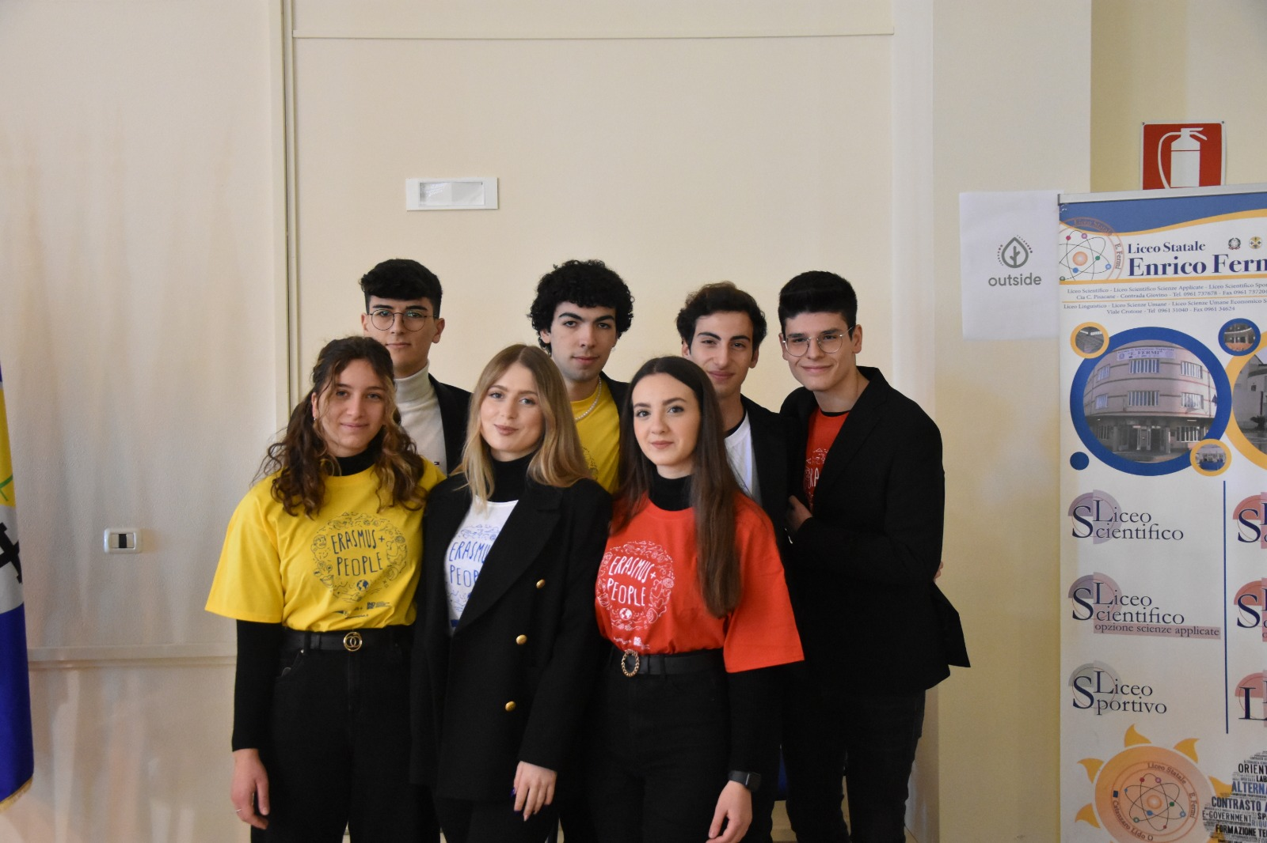
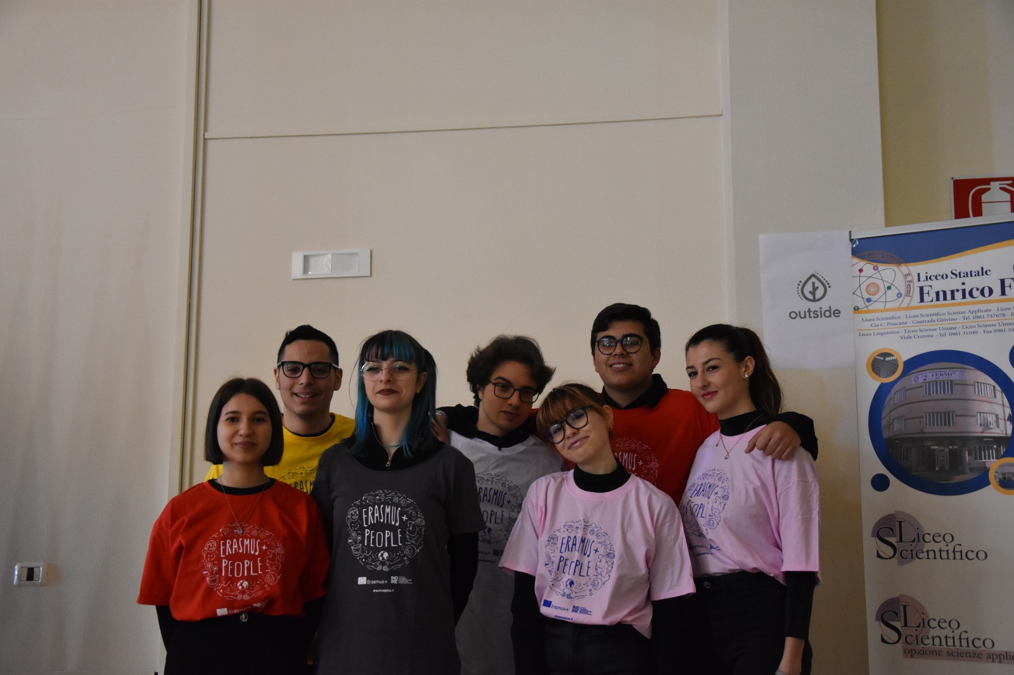
In addition, "it was a project that gave us the opportunity to experience the open schooling methodology. These are the experiences that make us grow and make us understand the beauty and diversity of the world outside the four walls we are used to living in. It wasn't easy, as we had to get together in groups and create a hypothetical project from scratch for experts to carry out-we had never faced such a realistic and serious task. We almost felt older, responsible and independent adults who had to perform a vital task: this was not one of those usual extracurricular activities that most of the time turn out to be boring, but the opposite. We all gave the best we had to offer, made the most of our abilities, and the result, in my personal opinion, was fantastic. We had fun, and for the first time we felt heard and realized that we also had value within larger affairs than ourselves!"

Slide 16
The goal of the project was to develop skills and, above all, ideas to meet the environmental challenges to which the world is called; in addition, to have students acquire those entrepreneurial skills through the experimentation of an educational methodology that promotes the active role of the student in learning processes and that focuses on new technologies.

Slide 17
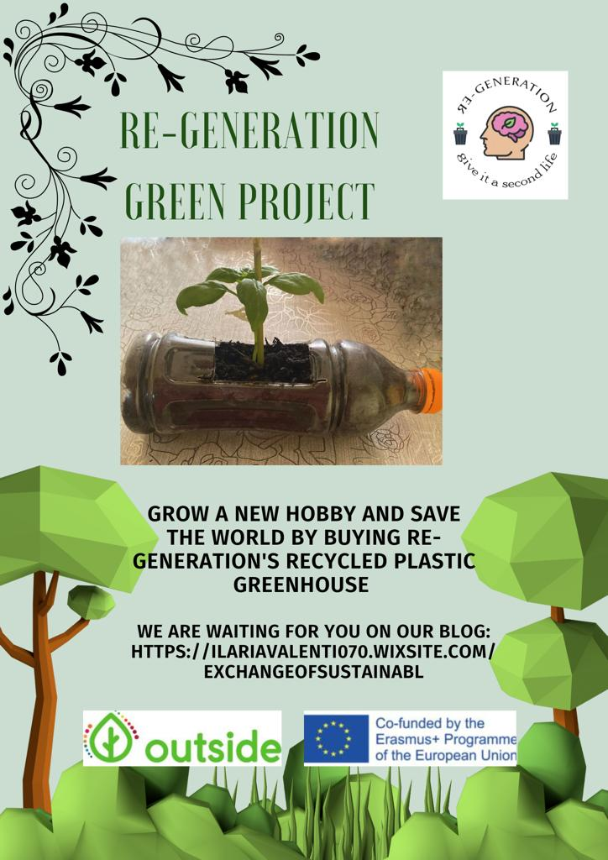

Slide 18
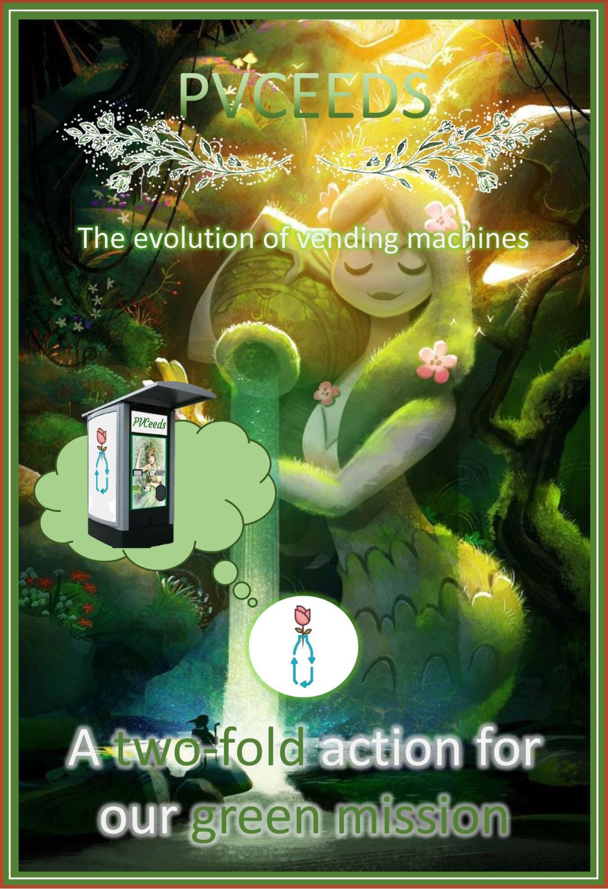
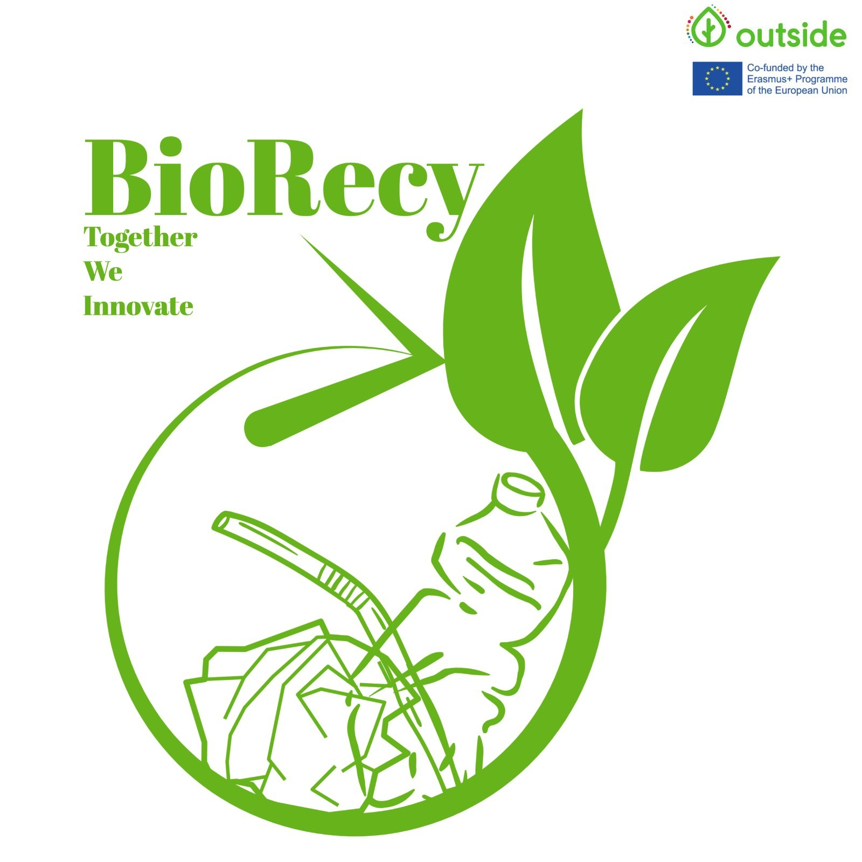

Slide 19
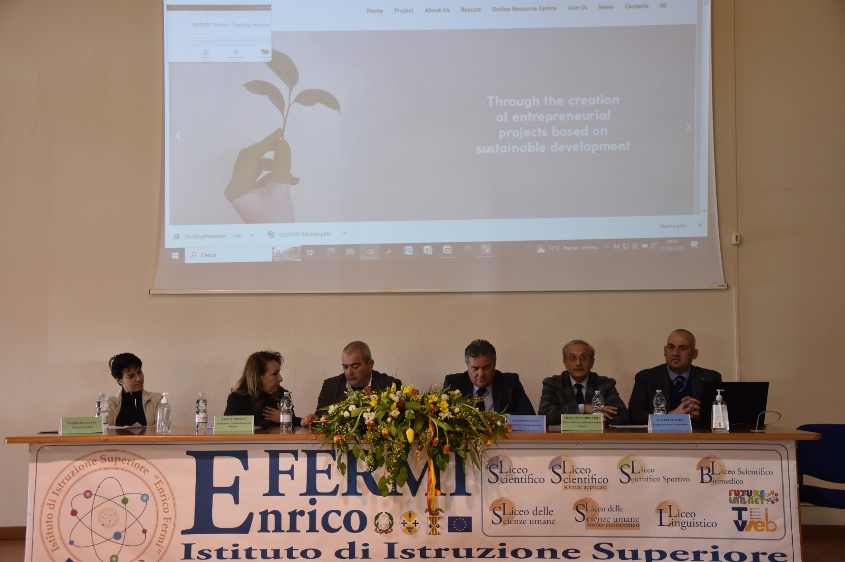
Testifying to the strong link between the institute and the Calabrian territory were Dr. Francesco Chiellino, Director of the Agriculture Sector of the Calabria region, Walter Pacida, entrepreneur as well as provincial president of Confagricoltura, Valentina Mazza representative of WWF of Catanzaro and Mrs Savina Moniaci, provincial ambassador of the Erasmus + Program

Slide 20
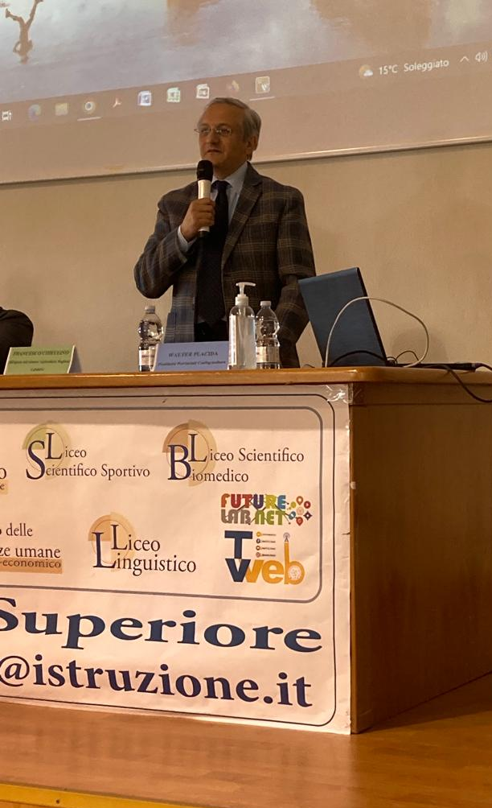
Walter Placida Entrepreneur/Provincial President Confagricoltura
Valentina Mazza WWF Catanzaro
Francesco Chiellino Head of the Agriculture Sector of the Region of Calabria
Filippo Mancuso, President of the Regional Council

Slide 21
Savina Moniaci Provincial Ambassador of the Erasmus + program.
Dr. Giulio Benincasa, institutional contact person Erasmus+ Program / and Twinning USR Calabria concluded the works, who emphasized the importance of "acquiring transversal skills so that all teachers can involve their colleagues and students in this training adventure. This great achievement, allowed IIS Fermi to tell us about and design some really innovative startups."

Slide 22
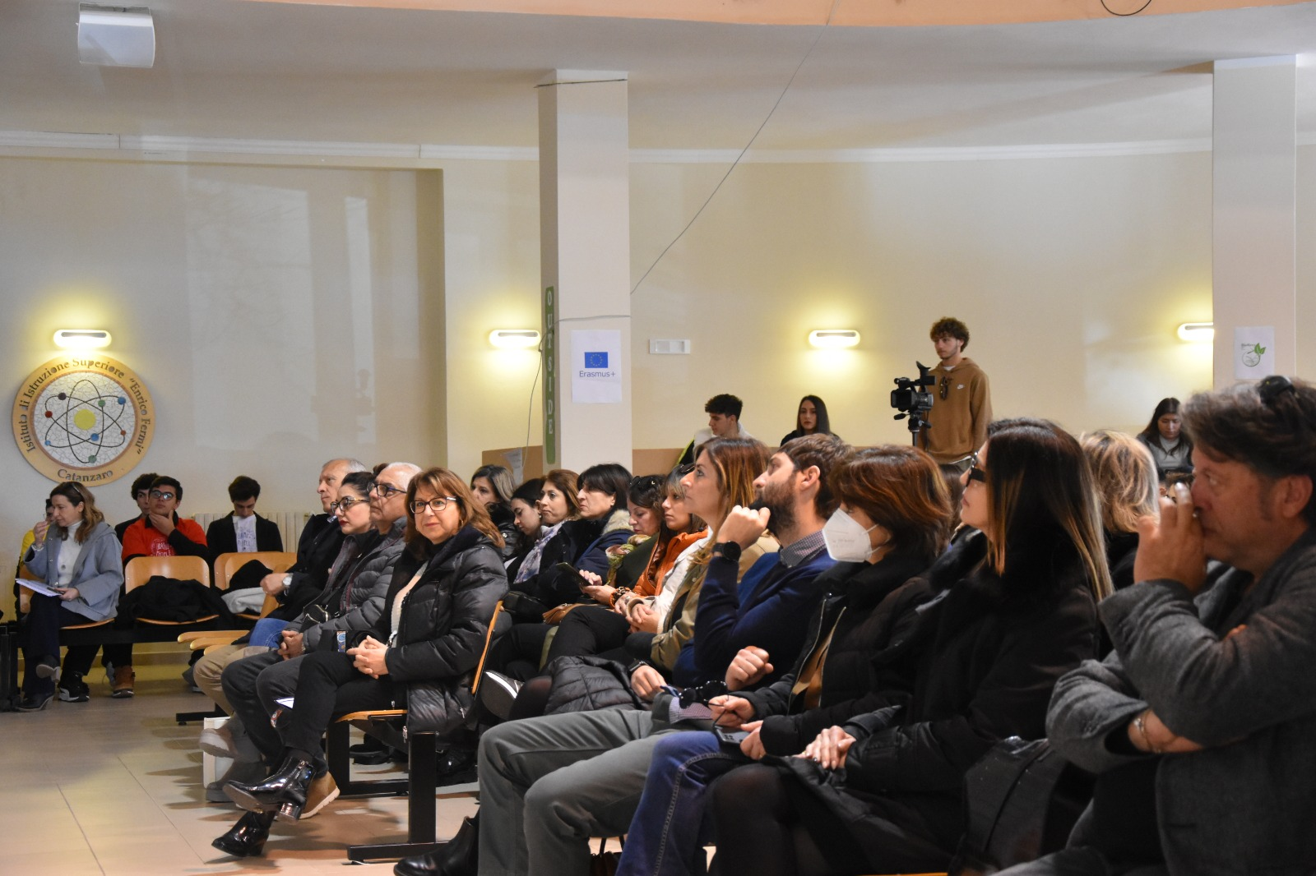
Great satisfaction of the "IIS FERMI" for the recognition received by the guests, who congratulated the enthusiasm of the children and their ideas convinced of the fact that, as Dr. Placida said " the future is in the hands of the younger generations and, if the new generation will be so well trained and directed on a renewed respect for the environment and such innovative and ecological ideas, these generations will know and will be able to heal the damage of those who have preceded them."

Slide 23
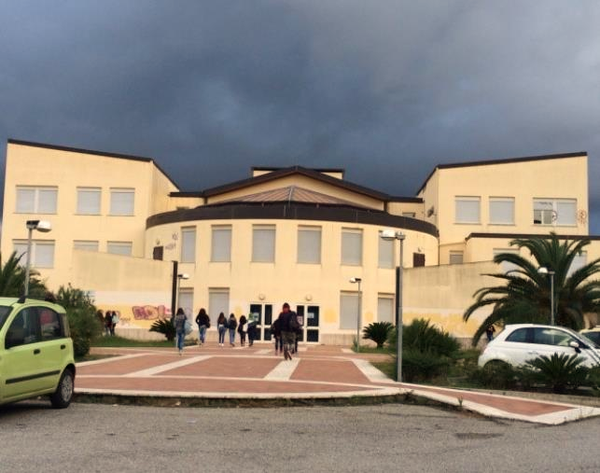
This was also made possible by the obvious teamwork of talented students and school staff who are passionate about their job.

Slide 24
Thanks for your attention!
The European Commission's support for the production of this publication does not constitute an endorsement of the contents, which reflect the views only of the authors, and the Commission cannot be held responsible for any use which may be made of the information contained therein.
OUTSIDE - Open commUniTies for SustaInable DevelopmEnt Nr. 2020-1-IT02-KA201-079803

