Slide 1
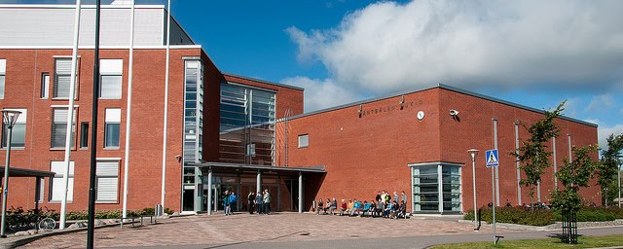
Mäntsälän lukio
Mäntsälä Upper Secondary School

Slide 2
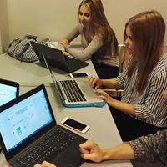
Some facts
founded in 1954
school building constructed in 2007
the number of students approximately 300
the teaching staff 15-20
student support: careers counsellor, nurse, psychologist, social worker, special needs teacher
all the classrooms are equipped with information technology. Ist year students are given a personal laptop.

Slide 3
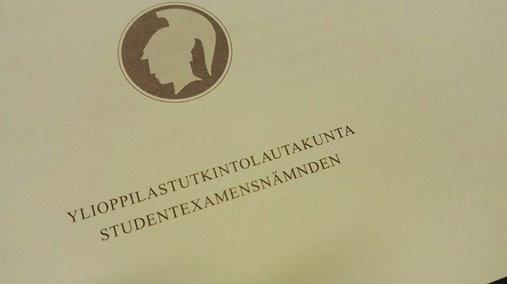
About studies
non-graded (= individual curriculums)
general education
5-6 periods/school year different subjects and timetable
one period (~7 weeks+exam week)
subjects divided into modules (courses)
obligatory
optional
applied
3-4 years to graduate
to graduate you’ll need min. 75 modules + final exams
a basis for studying in universities or universities of applied sciences

Slide 4
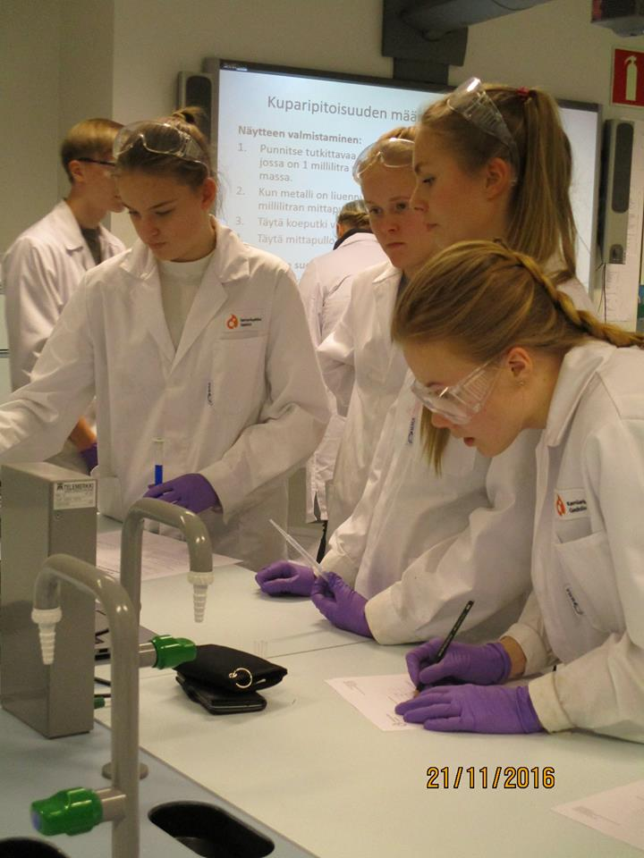
Subjects
Finnish (6) | Philosophy (2)
Swedish (5) | Psychology (1)
English (6) | Religion/Ethics (2)
French, German, Spanish, Russian | History (3)
Mathematics (advanced 10, basic 6) | Social Science (3)
Biology (2) | Health Education (1)
Geography (1) | Sports (2)
Physics (1) | Visual Art (1-2)
Chemistry (1) | Music (1-2)
Study/Career couselling (2)

Slide 5
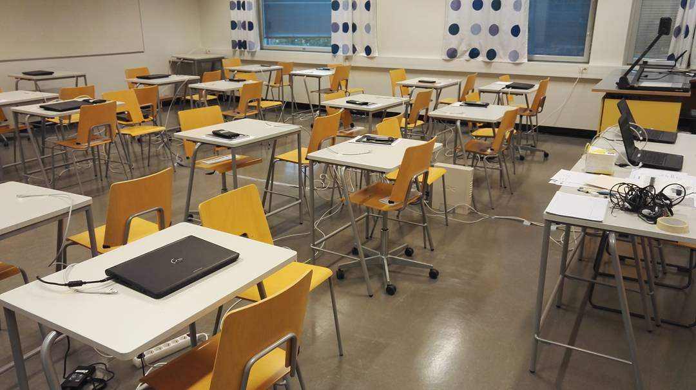
Matriculation Examination (Final exams)
min. 4 subjects
Finnish + one subject of advanced curriculum (math, language)
others according to interest
exam session twice a year
to be finished in three successive sessions
6 different grades (L, E, M, C, B, A (I))
Diplomas (art, music, sports)
digitalisation 2016-2019

Slide 6
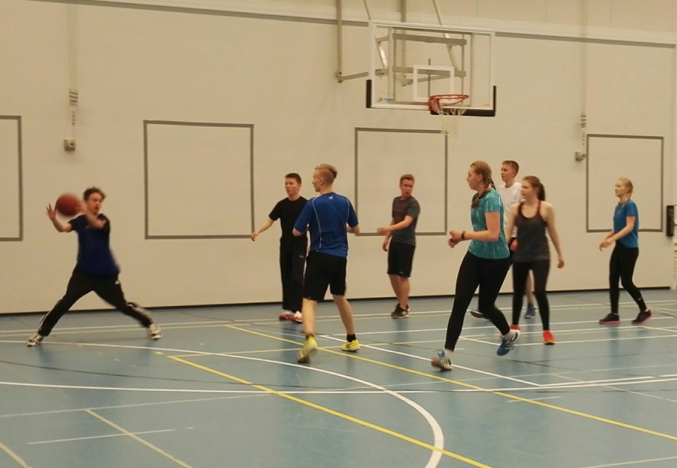
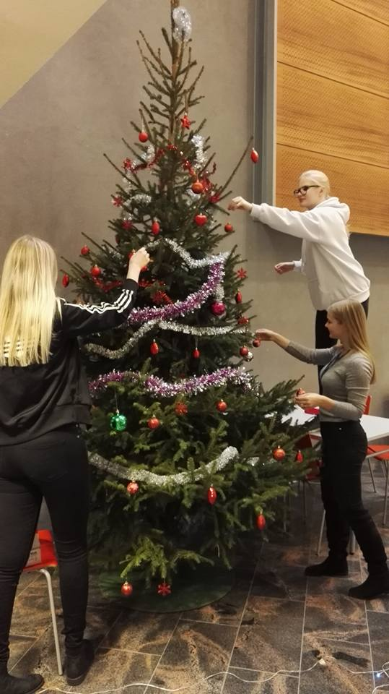
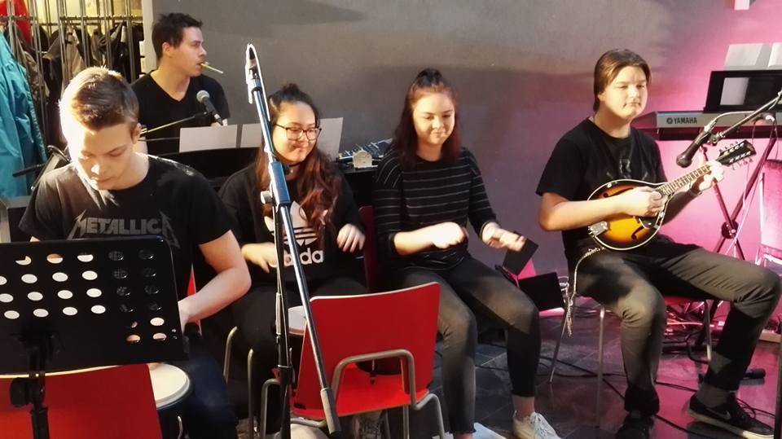
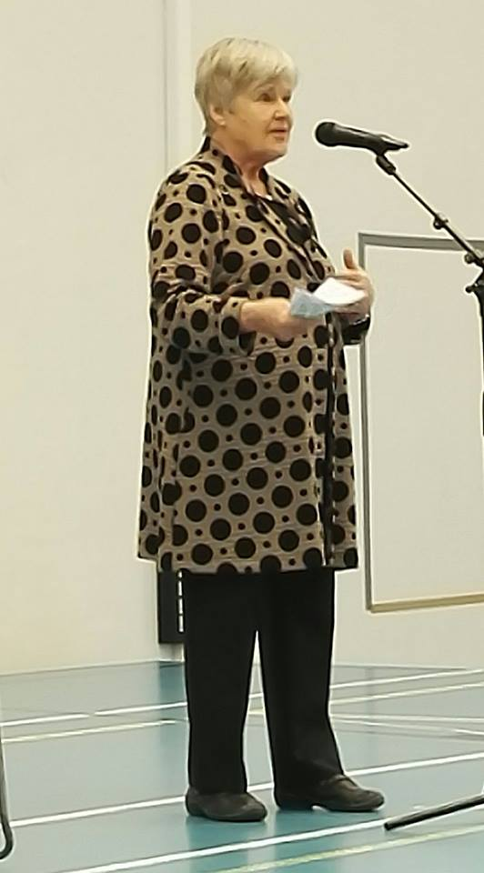
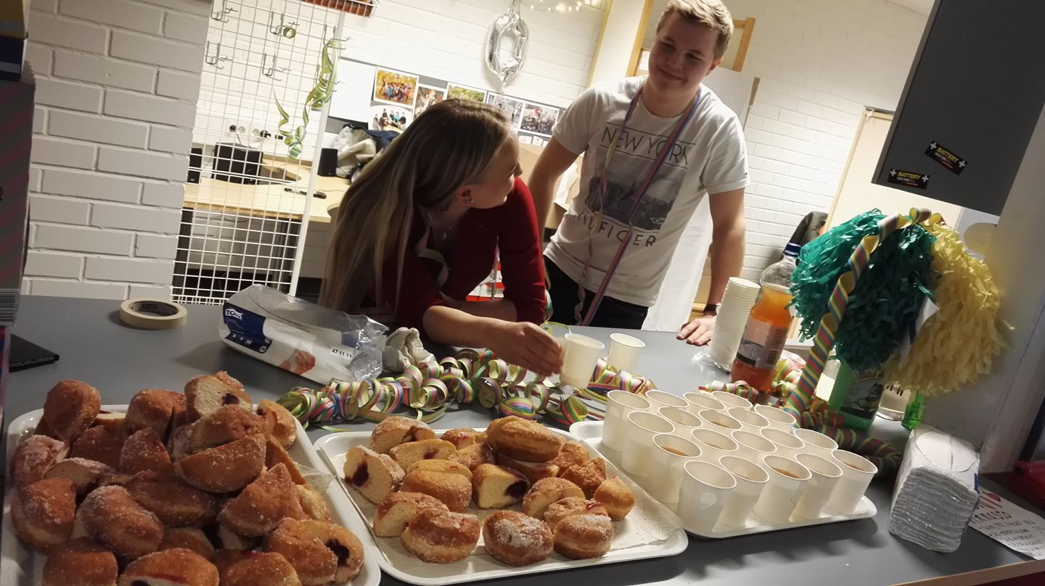
More than studying

Slide 7
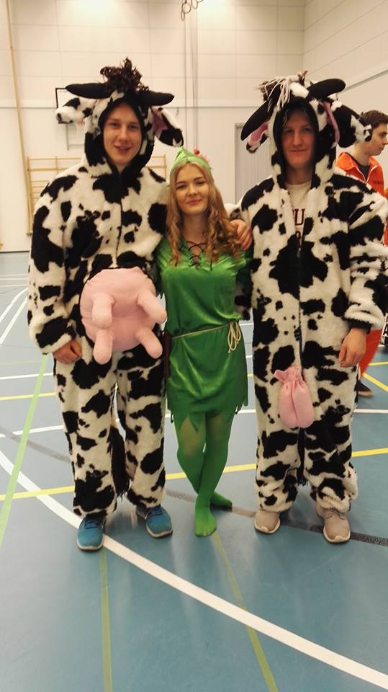
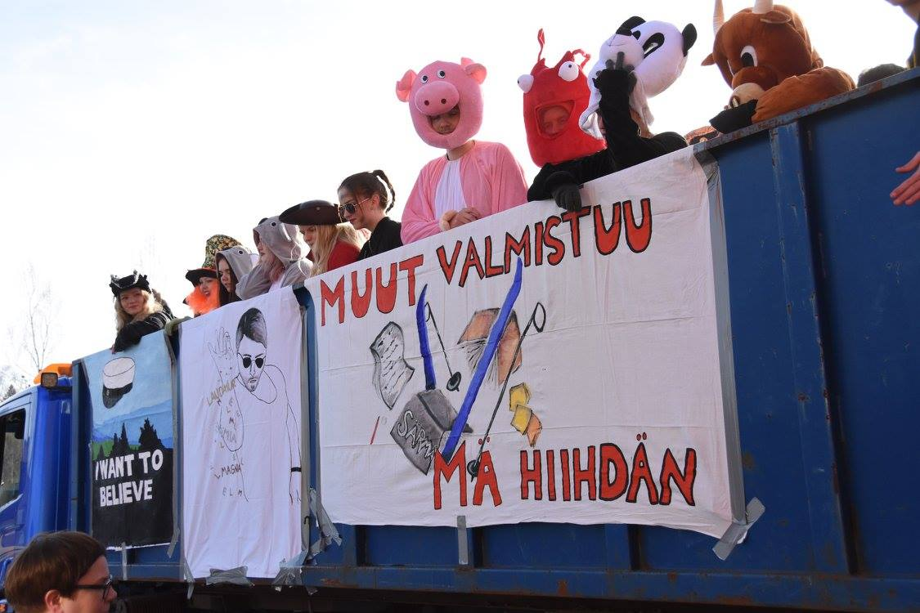
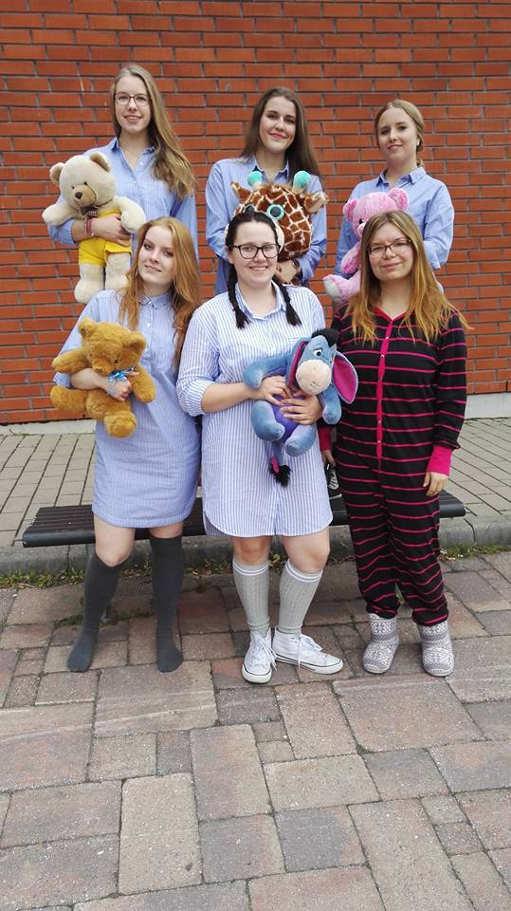
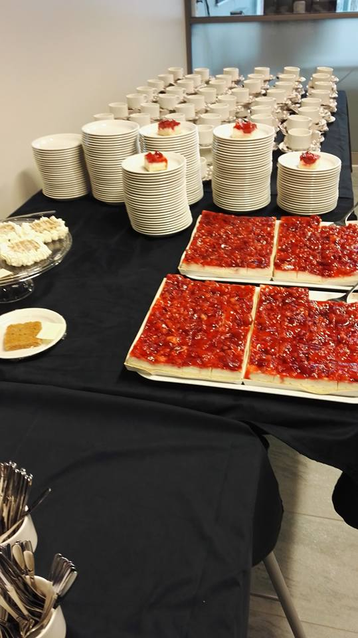
Traditions

Slide 8
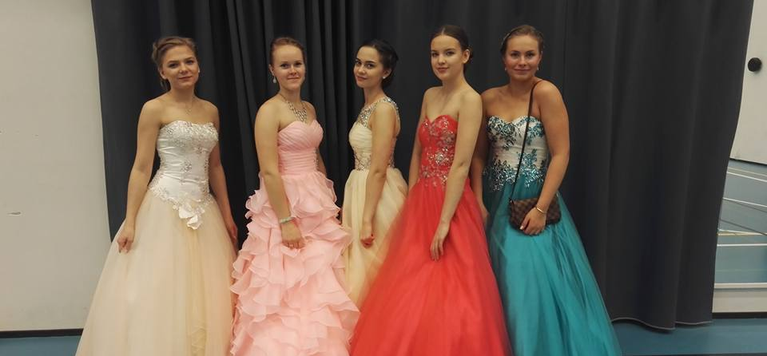
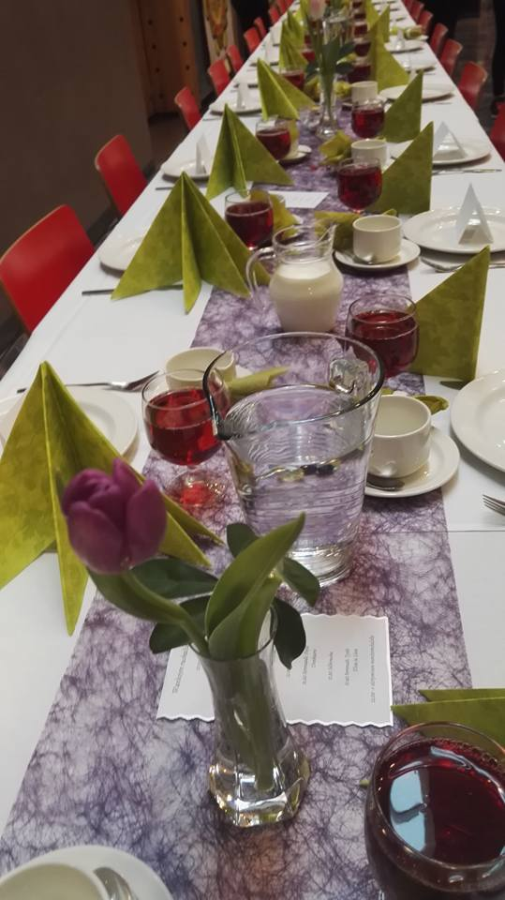
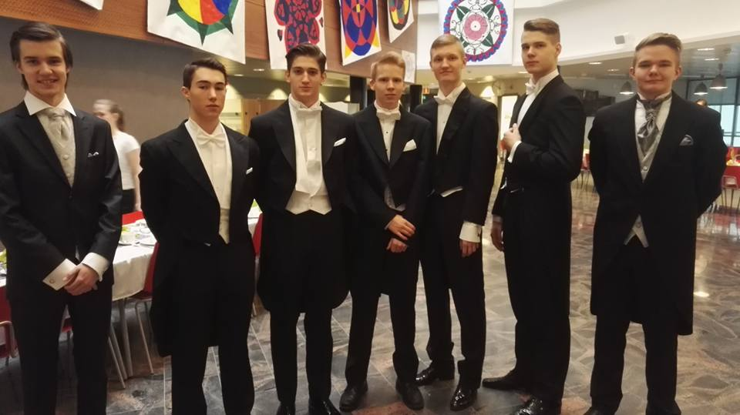
More traditions

Slide 9
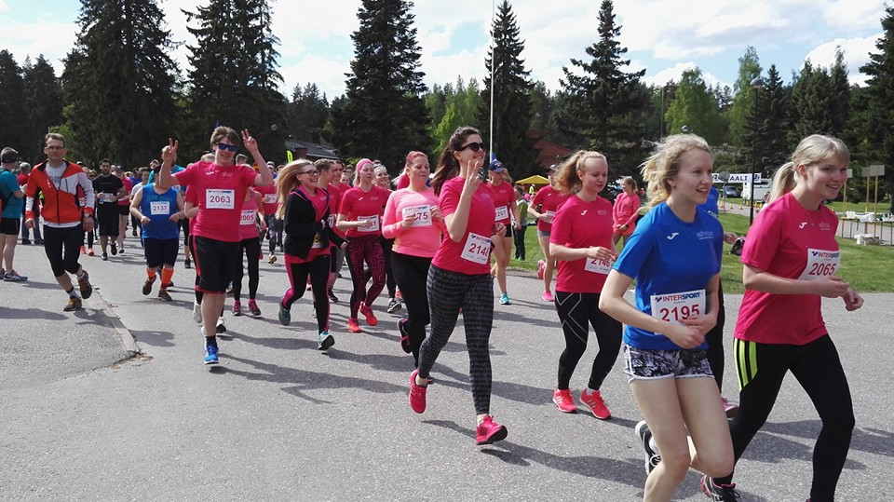
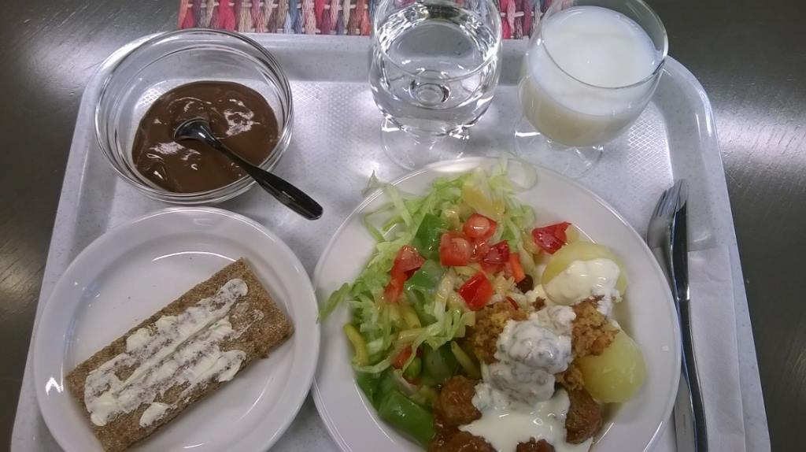
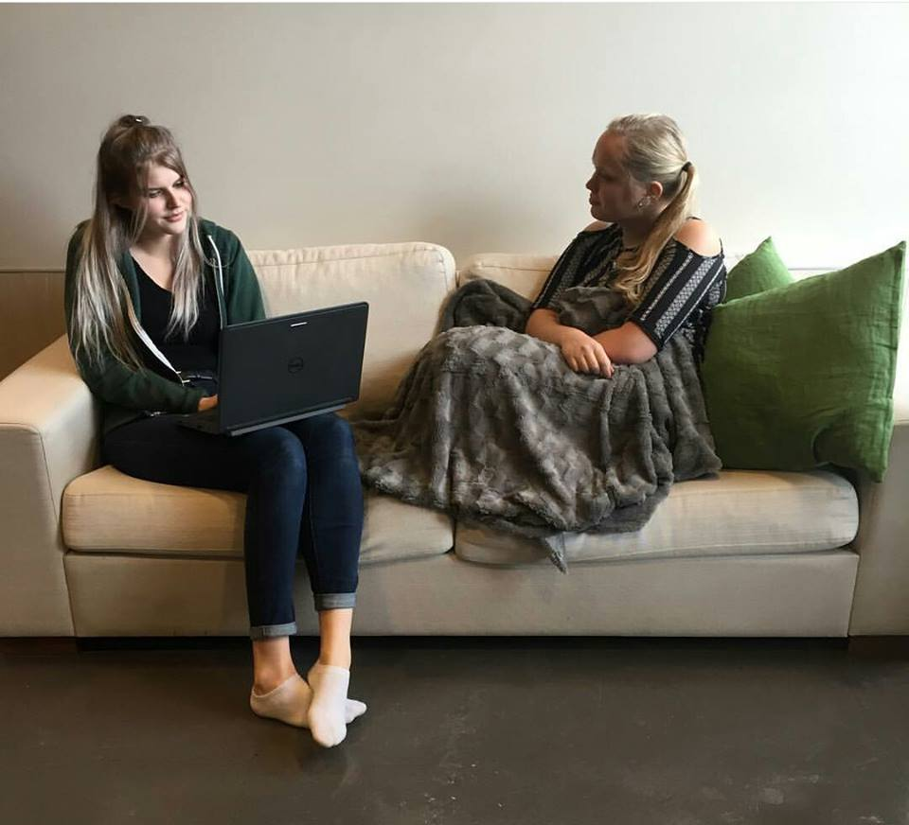
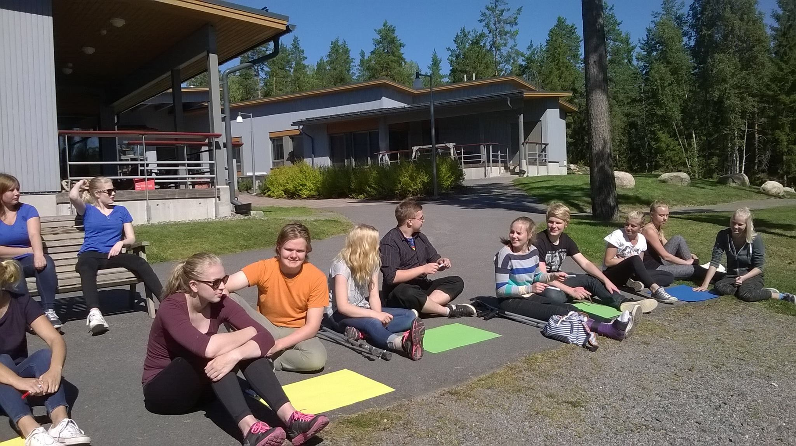
Mens sana in corpore sano

Slide 10
